Slide 1
Project Name: The Rising Sports Club (Sports Complex Management System)
Project Member:
Aniket Patil 220341220020
omkar Sudrik 220341220123

Slide 2
Introduction:
A sport club management system provides and manages various club activities such as member registration, registration for various sports, getting sports details and more. The sports club management system software is a system that manages the entire club activities and provides respective functionality for various types of visitors. It allows normal users to avail for club membership, to subscribe for desired game and achieve the membership through registration.
This is a crucial factor in having an online sports club website, that keeps itself fresh and live and updated at all times. This is sport club management system...to be well organized sports activities it needs to be user friendly as well as well managed.

Slide 3
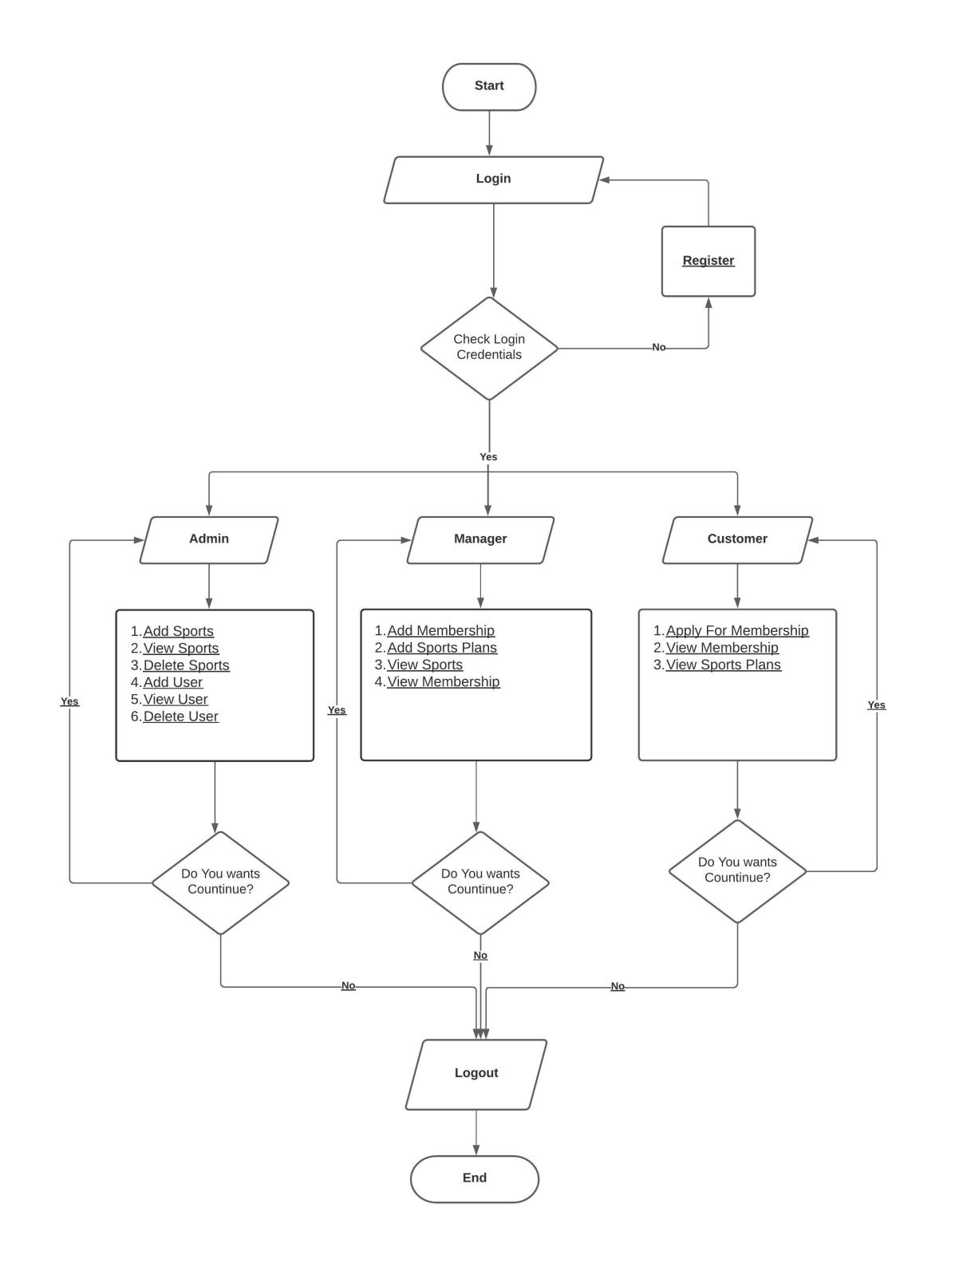
Flowchart:

Slide 4
Functionalities provided:
1) We have given different roles for different tasks using manager, admin, user so each of three will handle tasks individually.
2) we also trying to keep different account logins for this three for security so system could be transparent

Slide 5
Flow Of Project:
This system is being with three-layer management including three major roles for better safety, convenience & speed.
Member: after login user will able to see the all sports which are available in club. When user will click on particular sport then he will get the details of that sport like offers, batch timings, fees if user wants to proceed further, he can subscribe to that sport.
Admin: Admin can check and verify various member details. He can approve or disapprove the membership. After user subscribing for particular sport, admin will transfer this to manager. If manager agree and accept then admin can add that user to that sport.
Manager: he will manage the sport created by admin, e.g., creating new batches, new offers according to season, scheduling sports and launching them...

Slide 6
Advantages :
It becomes convenient for members to subscribe sports without actually visiting the place thus saves their time.
The system stores and sends all the members details to the admin for requests.
The system is easy to use and saves human efforts and cost.

Slide 7

Homepage :

Slide 8
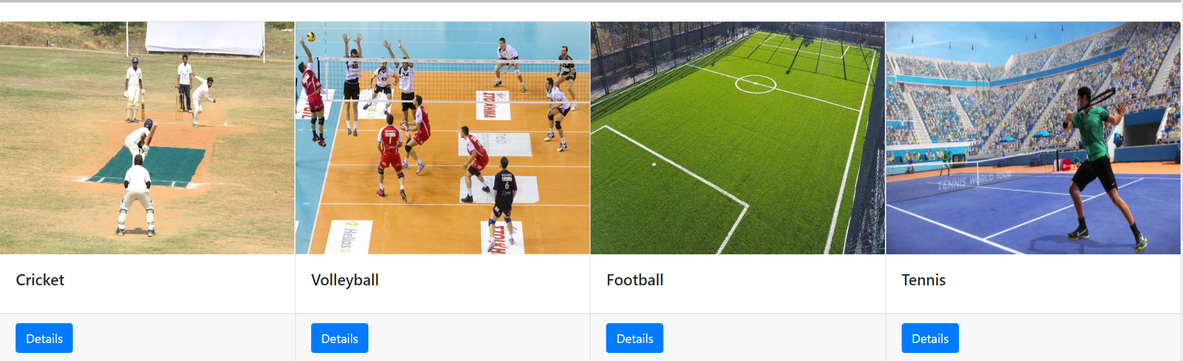
Sport Information :

Slide 9
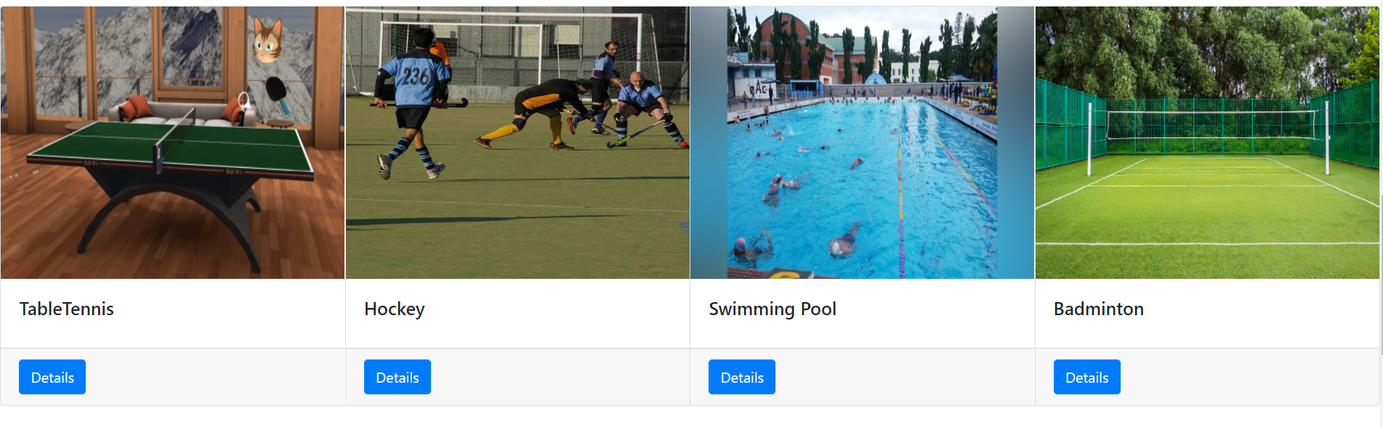

Slide 10
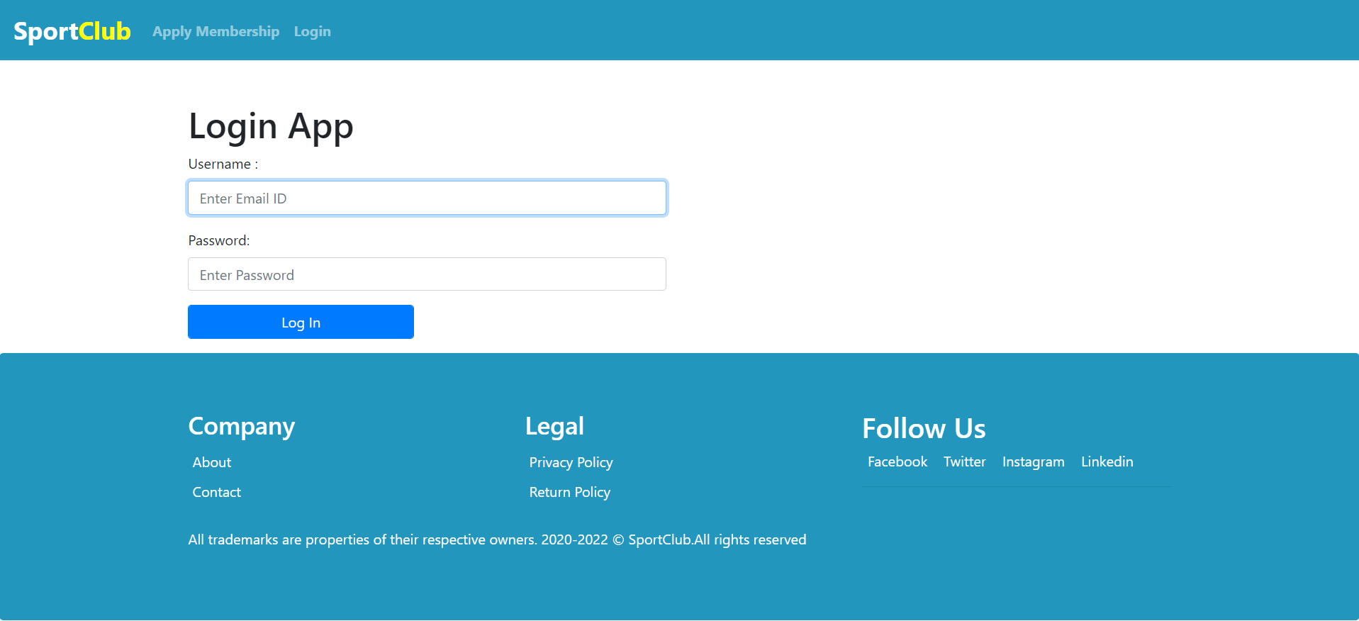
Login Page :

Slide 11
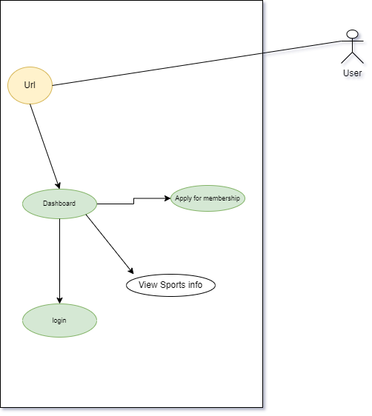
User Module :

Slide 12
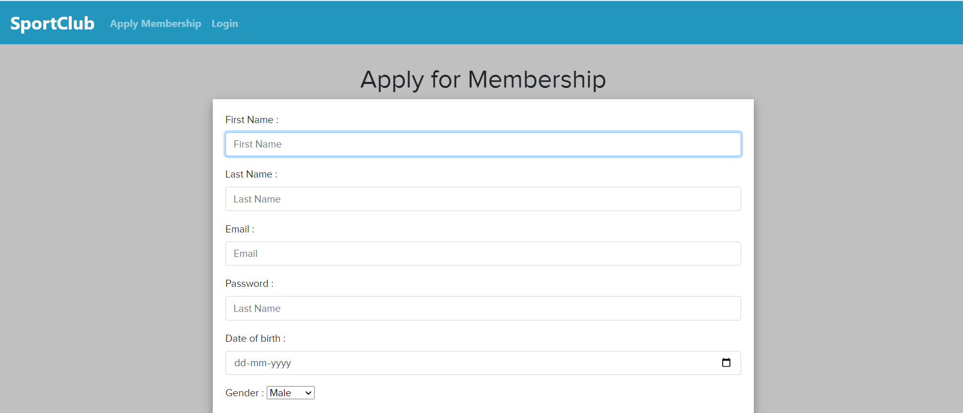
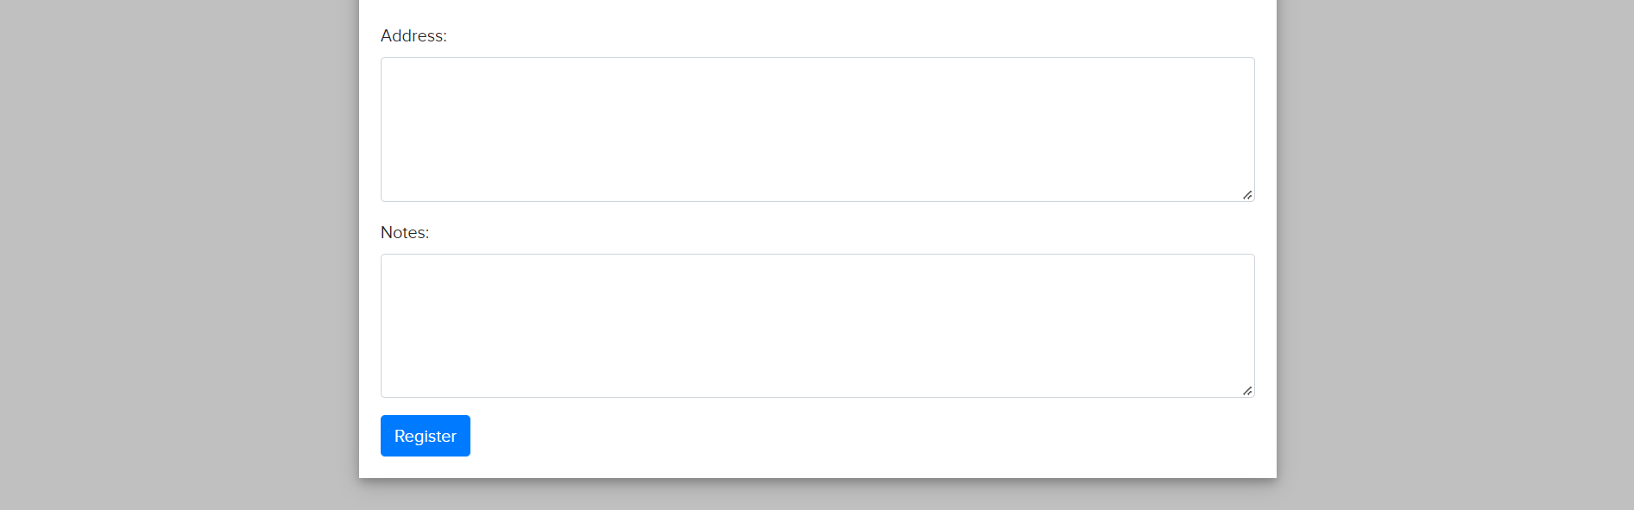
Apply for Membership :

Slide 13
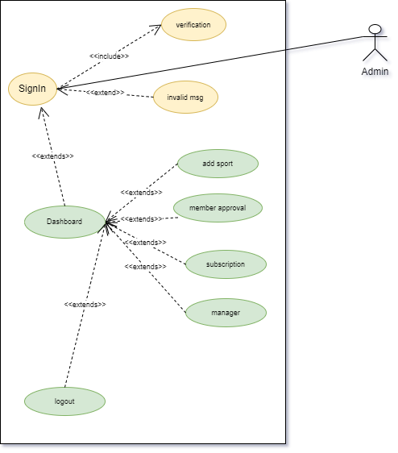
Admin Module :

Slide 14
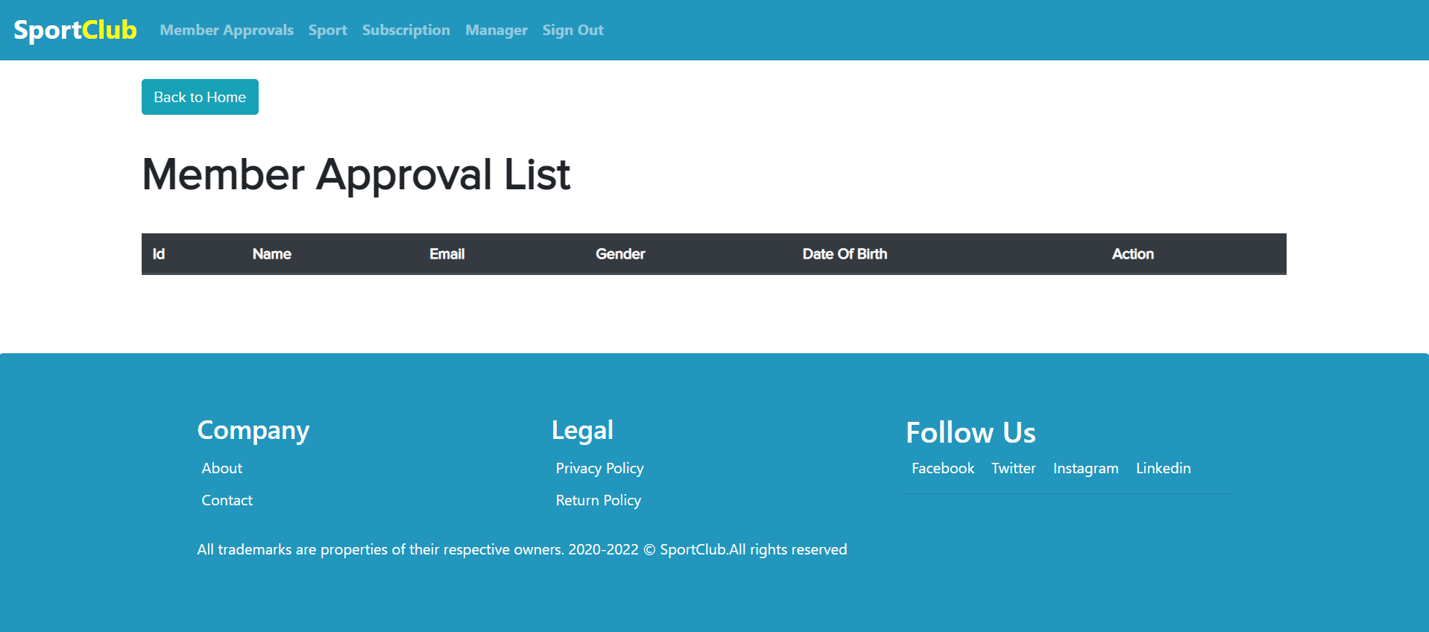
Member Approval List :
:

Slide 15

Sport List :

Slide 16
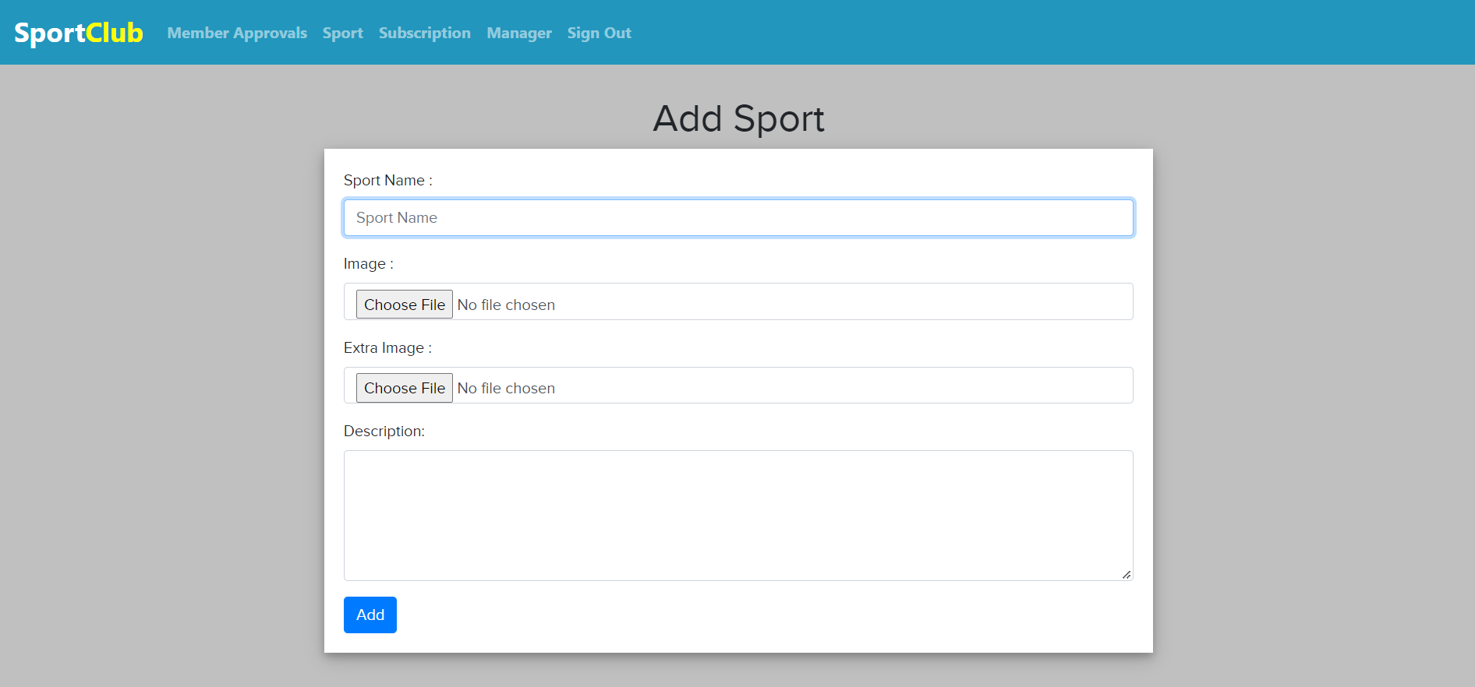
Add Sport :

Slide 17
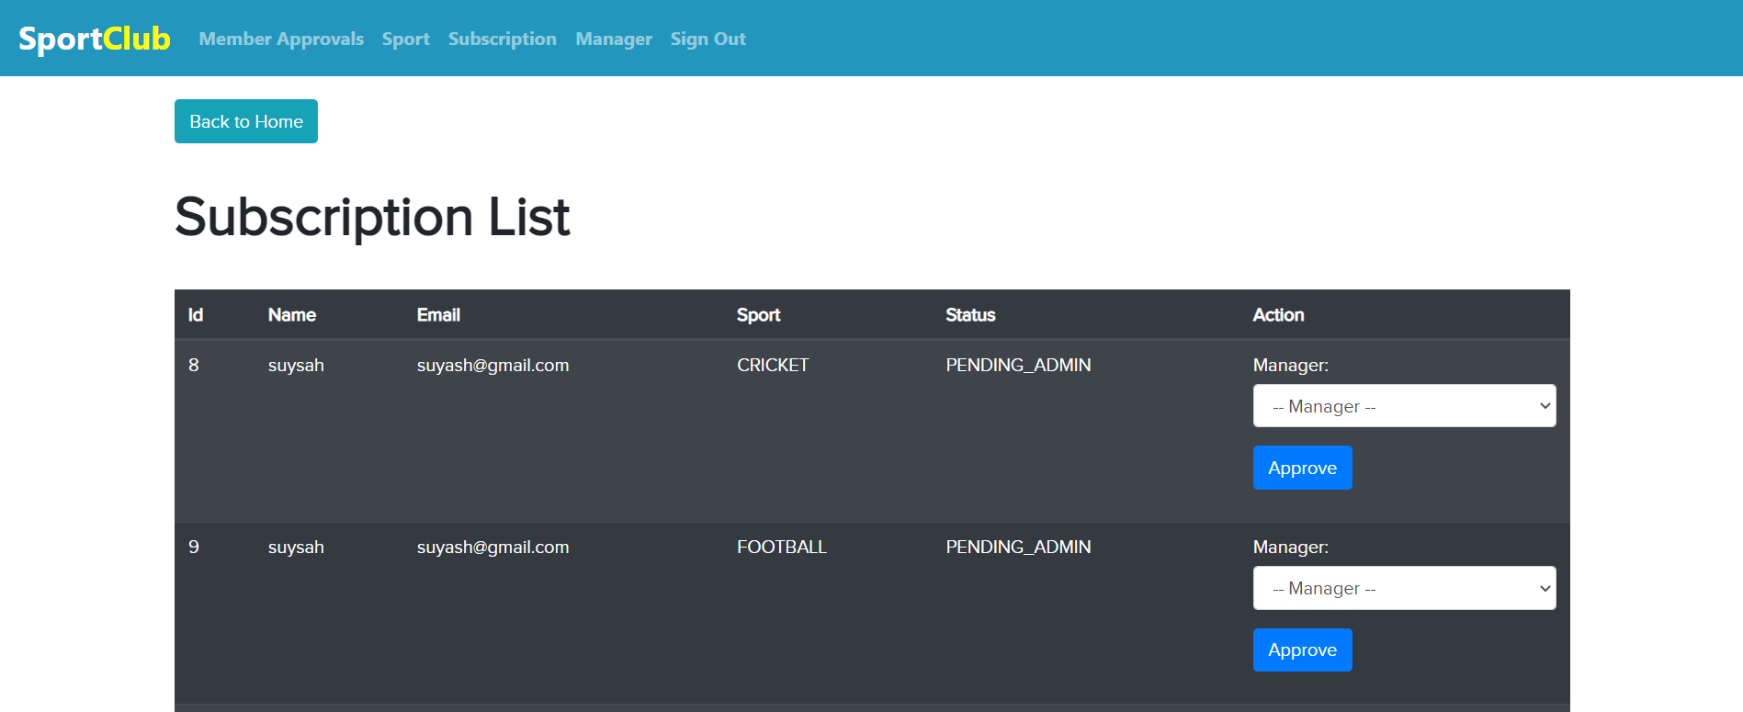
Subscription List :

Slide 18
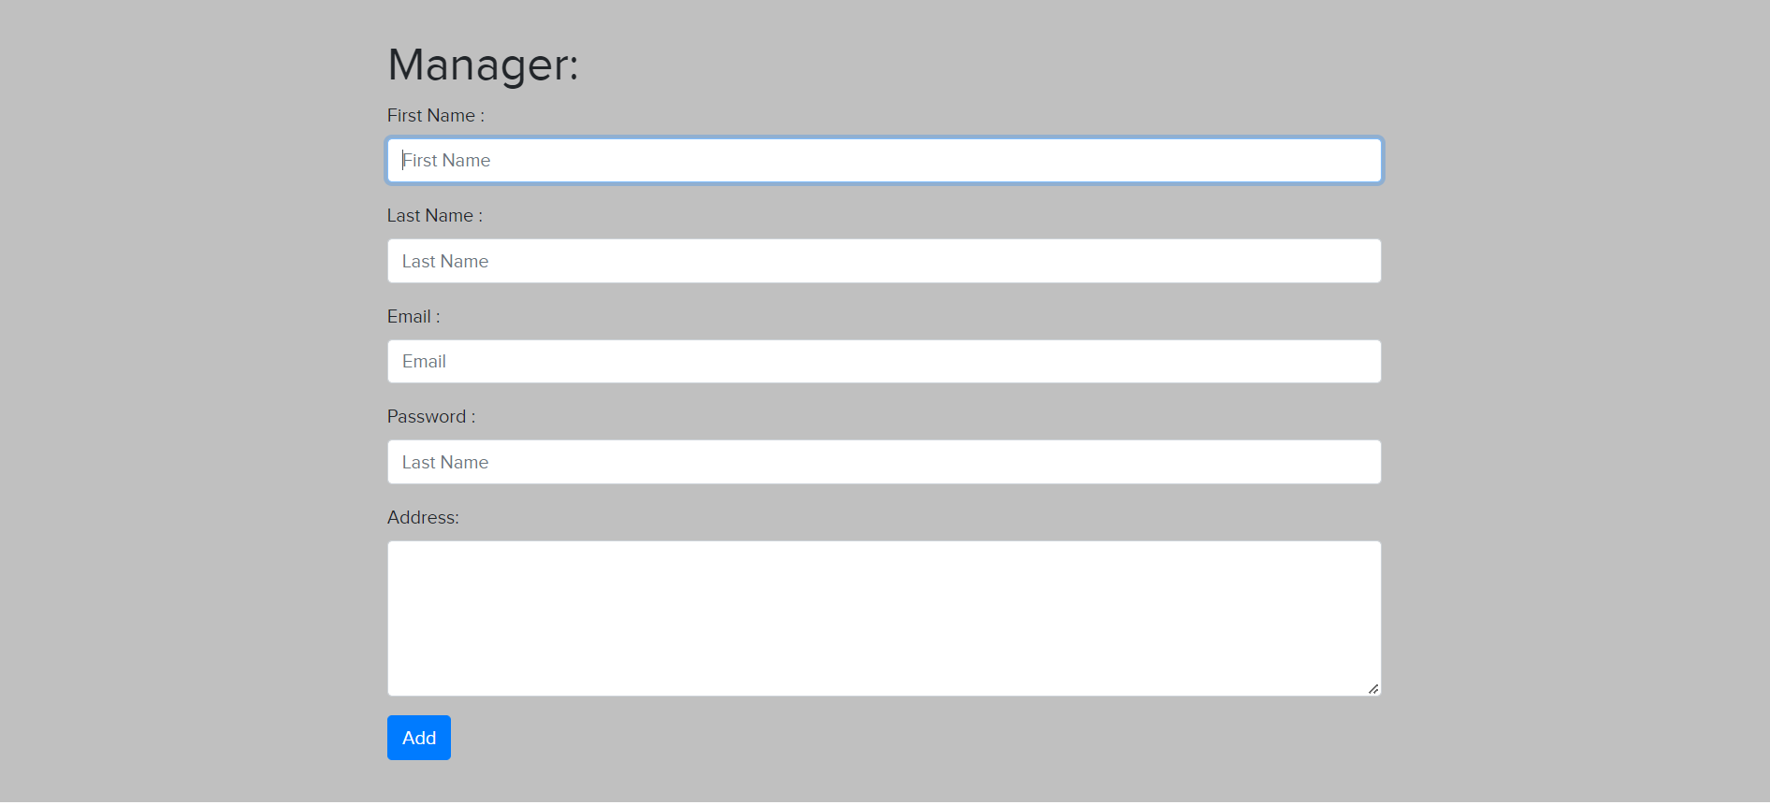
Add Manager :

Slide 19
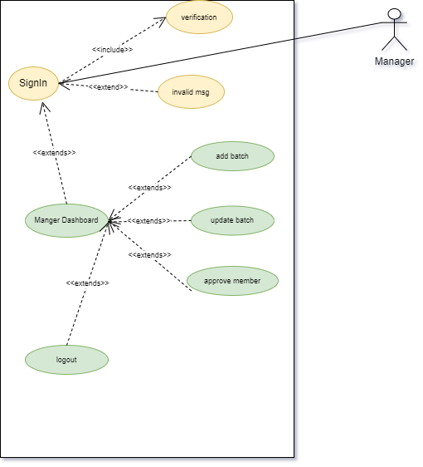
Manager Module :

Slide 20
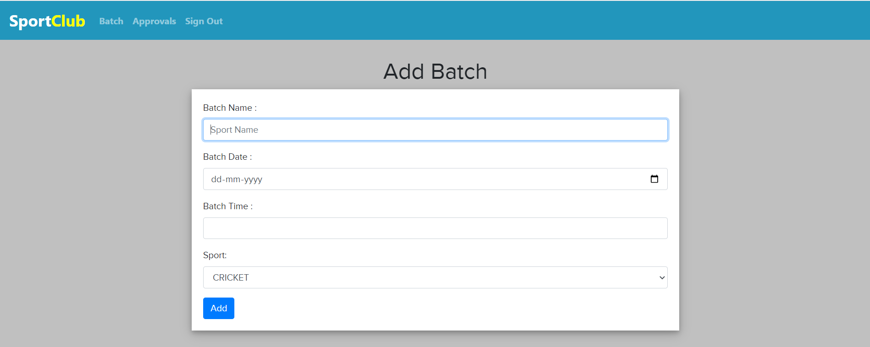
Add Batch :

Slide 21
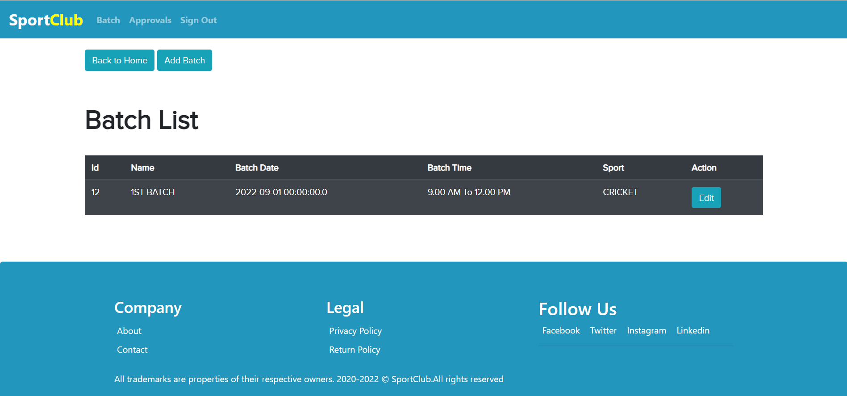
Batch List :

Slide 22
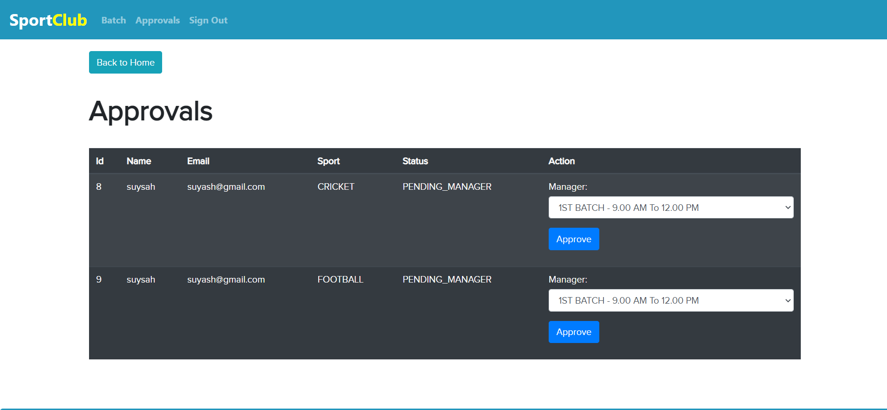
Approve And Assign Batch to Members :

Slide 23
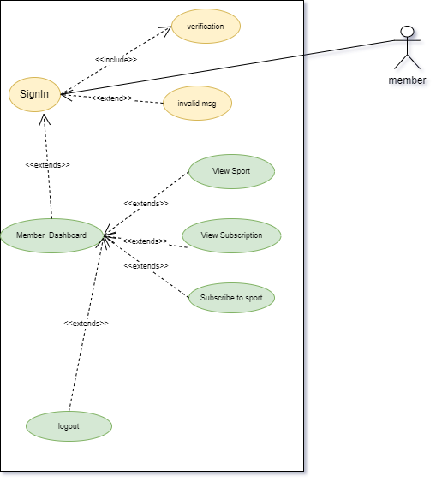
Member Module :

Slide 24

See Sport List :

Slide 25
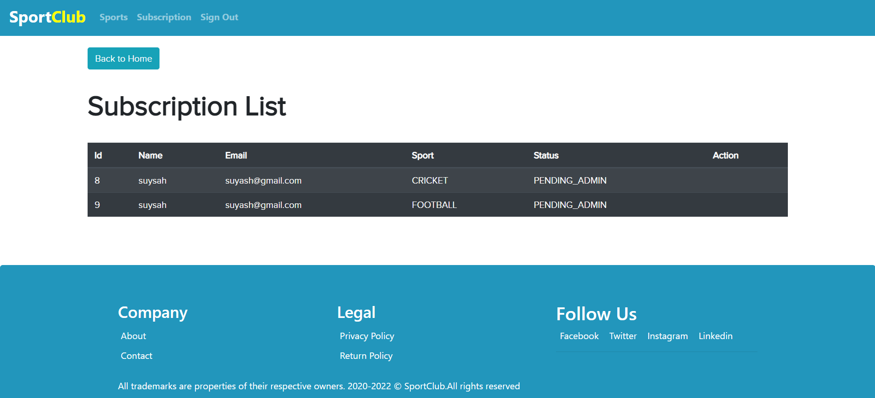
Subscription Status :

Slide 26
Thank You!

